Slide 1
AI Overview
Jun Liu v0.1

Slide 2
Agenda
Part I
What is AI?
AI Journey
Typical AI Application
Problems Faced
Part II
What is NN?
The example of binary clarification
Demo

Slide 3
What is your first impression of AI?

Slide 4
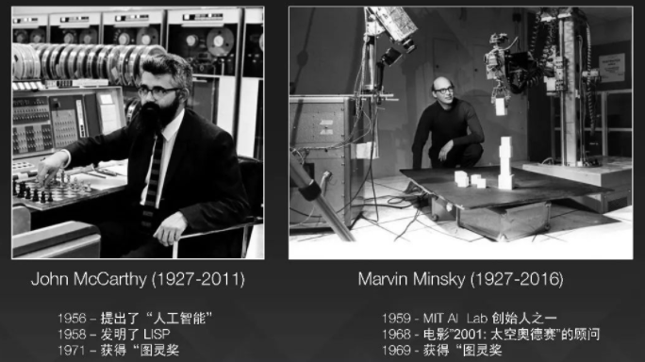
What is AI
AI is a hot concept appeared overnight?
AI has a long history over 60 years.

Slide 5
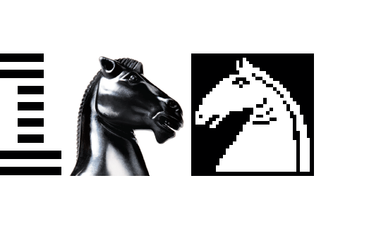



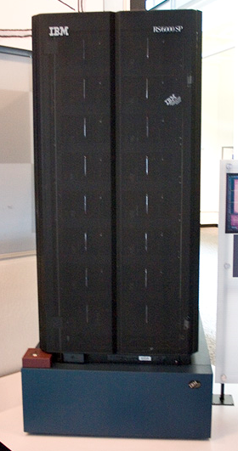
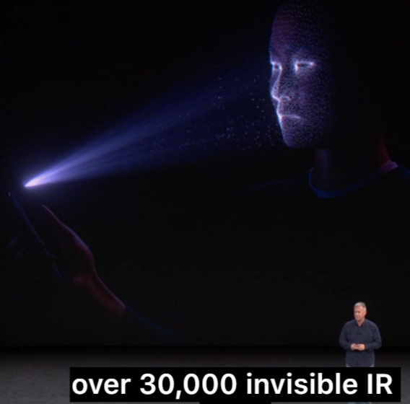
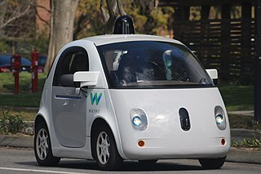
AI Journey
Claude E. Shannon
Alan M. Turing
…
Dartmouth Workshop
John McCarthy
Marvin Minsky
Claude E. Shannon
…
Deep Blue Kasparov
3.5 : 2.5
Alpha Go Lee Sedol
4 : 1
Alpha Go Ke Jie
3 : 0
AD
1956
1997
2016
2017
Co-Innovate with TMO and RNAM to co-create IAM
Notes:
Turning:《計算機器和智能》（Computing Machinery and Intelligence）
Enigma
Turing_machine: A Turing machine is a mathematical model of computation that defines an abstract machine^{[1]} which manipulates symbols on a strip of tape according to a table of rules
Weak artificial intelligence (weak AI), also known as narrow AI
Deep Blue: A chess-playing computer. The system derived its playing strength mainly from brute force computing power. It was a massively parallel, RS/6000 SP Thin P2SC-based system with 30 nodes, with each node containing a 120 MHz P2SC microprocessor, enhanced with 480 special purpose VLSI chess chips. Its chess playing program was written in C and ran under the AIX operating system. It was capable of evaluating 200 million positions per second, twice as fast as the 1996 version. In June 1997, Deep Blue was the 259th most powerful supercomputer according to the TOP500 list, achieving 11.38 GFLOPS on the High-Performance LINPACK benchmark.
The Hitchhiker's Guide to the Galaxy : Deep Thought; Don’t Panic
AlphaGo: Monte Carlo tree search (1940s) and NN
In March 2016, it beat Lee Sedol in a five-game match (4:1)
In the 2017 Future of Go Summit, AlphaGo beat Ke Jie, the world No.1 ranked player at the time, in a three-game match. (3:0)

Slide 6
AI Journey
General AI/Strong AI and Narrow/Weak AI
Rule-based AI and Statistic-based AI
"machines will be capable, within twenty years, of doing any work a man can do.“ -- 1965
Notes:
Artificial general intelligence (AGI) is the intelligence of a machine that could successfully perform any intellectual task that a human being can.
The first generation of AI researchers was convinced that artificial general intelligence was possible and that it would exist in just a few decades.
In the 1990s and early 21st century, mainstream AI has achieved far greater commercial success and academic respectability by focusing on specific sub-problems where they can produce verifiable results and commercial applications, such as neural networks, computer vision or data mining.^{[27]} These "applied AI" systems are now used extensively throughout the technology industry, and research in this vein is very heavily funded in both academia and industry.

Slide 7
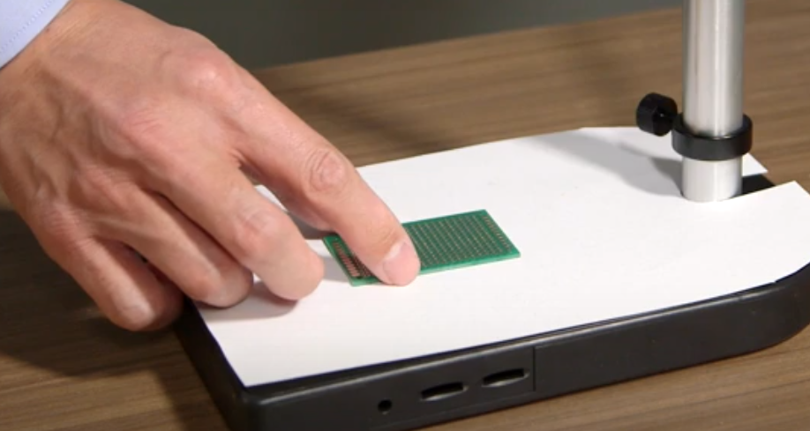
What is AI
AI can do everything?
AI can get the laws behind the data and compute faster than human beings.

Slide 8
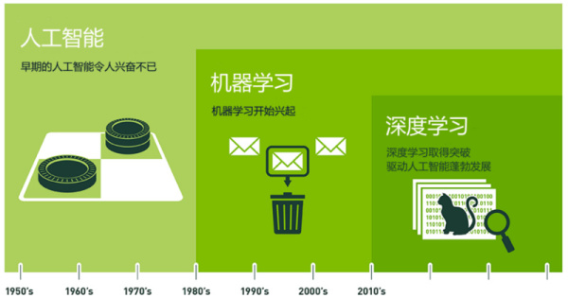
AI in Recent Years
Data Explosion (especially with Mobile Internet)
HW Computation Capability Explosion: Dedicated HW like GPU/TPU; Distributed Computation on commercial HW
AI Algorithms are still Old-fashion Algorithms, but with powerful AI frameworks.
Notes:
AI is the all encompassing umbrella that covers everything from Good Old Fashion AI (GOFAI) all the way to connectionist architectures like Deep Learning.
ML is a sub-field of AI that covers anything that has to do with the study of learning algorithms by training with data. There are whole swaths (not swatches) of techniques that have been developed over the years like Linear Regression, K-means, Decision Trees, Random Forest, PCA, SVM and finally Artificial Neural Networks (ANN).
King Me

Slide 9
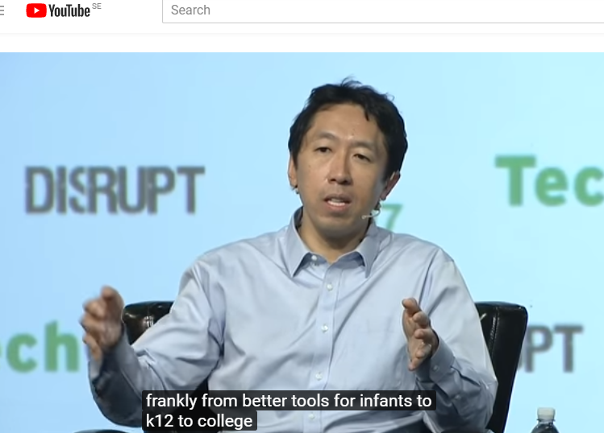
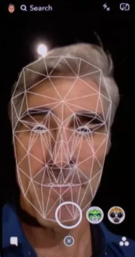
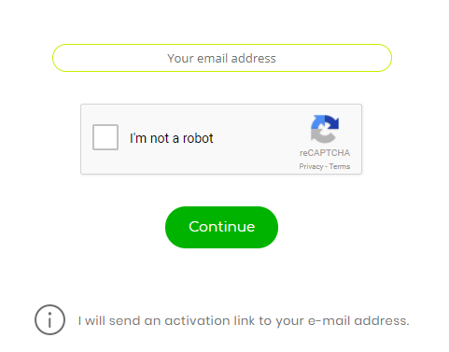


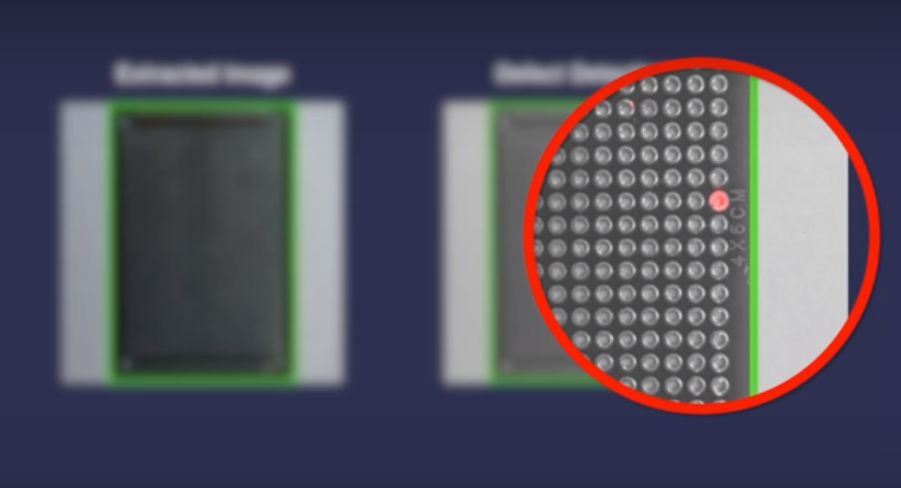
AI Usage
Speech Recognition/Auto Translation
IAM
Manufacturing
Personal Assistant
Notes:
https://blog.coursera.org/signaturetrack/
https://blog.coursera.org/a-milestone-for-signature-track-certificates-for/
https://security.googleblog.com/2014/12/are-you-robot-introducing-no-captcha.html?m=0

Slide 10
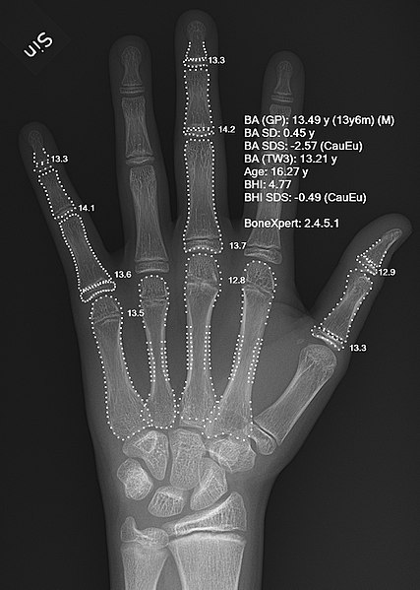
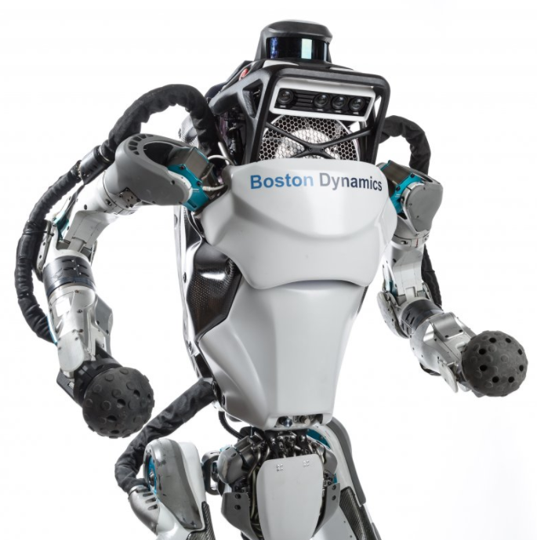
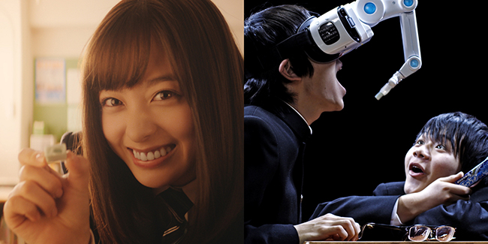
AI Usage
Robot
Healthcare
Virtual Reality
Self Driving Car

Slide 11
Problems AI Faced
I think AI is akin to building a rocket ship. You need a huge engine and a lot of fuel. If you have a large engine and a tiny amount of fuel, you won’t make it to orbit. If you have a tiny engine and a ton of fuel, you can’t even lift off. To build a rocket you need a huge engine and a lot of fuel.
The analogy to deep learning [one of the key processes in creating artificial intelligence] is that the rocket engine is the deep learning models and the fuel is the huge amounts of data we can feed to these algorithms.
- Andrew NG
Notes:
https://www.wired.com/brandlab/2015/05/andrew-ng-deep-learning-mandate-humans-not-just-machines/

Slide 12
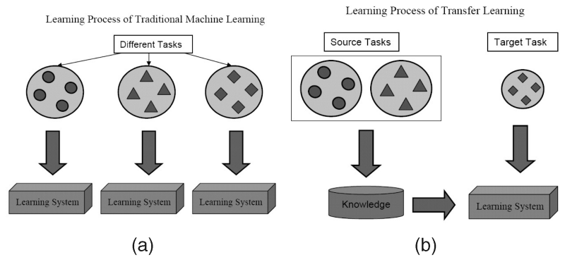
Problems AI Faced
Data Dependence
AlphaGo Master to AlphaGo Zero
Transfer Learning
Generalization
AlphaGo Zero to AlphaZero
No Standard
Open Neural Network Exchange (ONNX)
Notes:
Transfer learning or inductive transfer is a research problem in machine learning that focuses on storing knowledge gained while solving one problem and applying it to a different but related problem.^{[1]} For example, knowledge gained while learning to recognize cars could apply when trying to recognize trucks.
https://www.cse.ust.hk/~qyang/Docs/2009/tkde_transfer_learning.pdf
借助迁移学习技术，我们可以直接使用预训练过的模型，这种模型已经通过大量容易获得的数据集进行过训练（虽然是针对完全不同的任务进行训练的，但输入的内容完全相同，只不过输出的结果不同）。随后从中找出输出结果可重用的层。我们可以使用这些层的输出结果充当输入，进而训练出一个所需参数的数量更少，规模也更小的网络。这个小规模网络只需要了解特定问题的内部关系，同时已经通过预培训模型学习过数据中蕴含的模式。
AlphaGo Zero is a version of DeepMind's Go software AlphaGo. AlphaGo's team published an article in the journal Nature on 19 October 2017, introducing AlphaGo Zero, a version created without using data from human games, and stronger than any previous version.^{[1]} By playing games against itself, AlphaGo Zero surpassed the strength of AlphaGo Lee in three days by winning 100 games to 0, reached the level of AlphaGo Master in 21 days, and exceeded all the old versions in 40 days.^{[2]}
AlphaZero is a computer program developed by the Alphabet-owned AI research company DeepMind, which uses an approach similar to AlphaGo Zero's to master not just Go, but also chess and shogi.

Slide 13
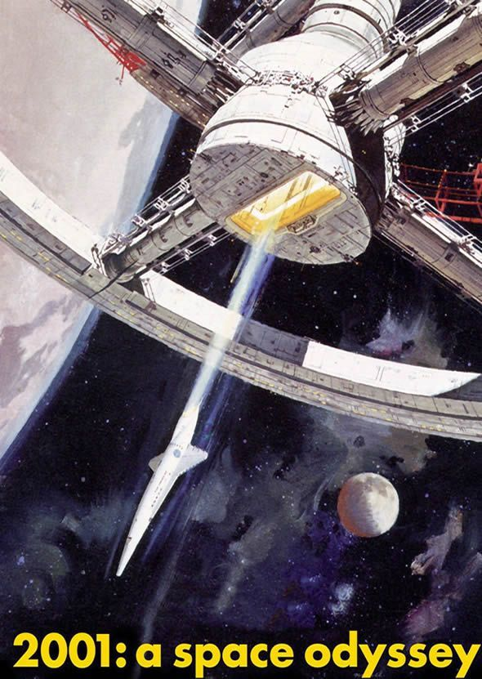
Problems AI Faced
The scope of AI
“A lot of cutting edge AI has filtered into general applications, often without being called AI because once something becomes useful enough and common enough it's not labelled AI anymore”
Where is HAL-9000?
Spiral rise
Notes:
In 1968, Arthur C. Clarke and Stanley Kubrick had imagined that by the year 2001, a machine would exist with an intelligence that matched or exceeded the capability of human beings. The character they created, HAL 9000, was based on a belief shared by many leading AI researchers that such a machine would exist by the year 2001.^{[164]}
In 2001, AI founder Marvin Minsky asked "So the question is why didn't we get HAL in 2001?"

Slide 14
What is Neural Network?

Slide 15
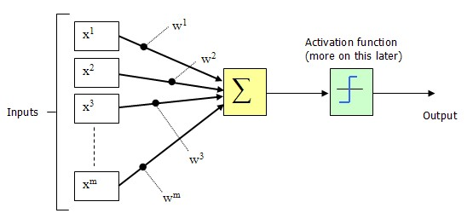
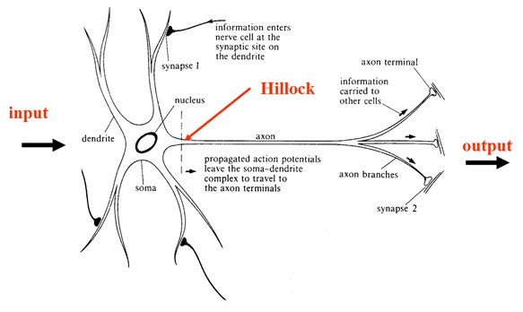
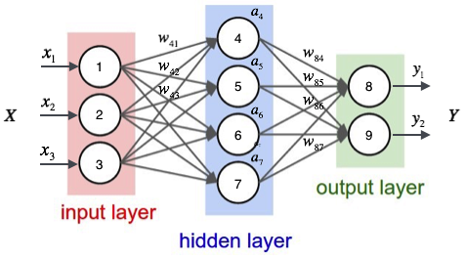
Neural Network
y = a * (W * x + b)
Notes:
x是输入向量，y是输出向量，b是偏移向量，W是权重矩阵，a是激活函数。每一层仅仅是把输入x经过如此简单的操作得到y.
http://cs.stanford.edu/people/karpathy/convnetjs//demo/classify2d.html

Slide 16



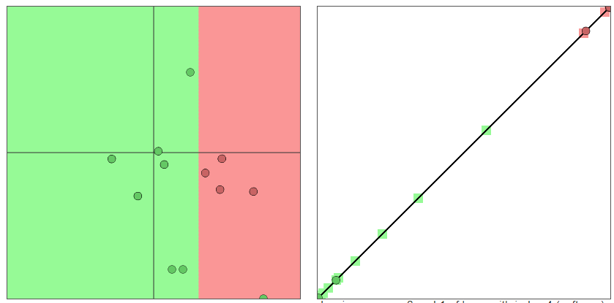
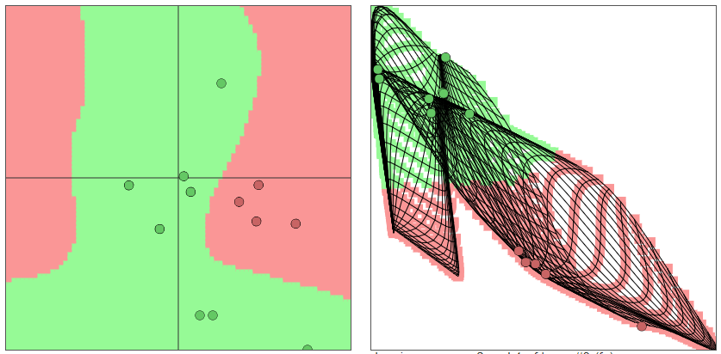
Binary Clarification
1 dimensional
2 dimensional
3 dimensional
How to teach a dog to distinguish the apple from the orange?
Notes:
x是输入向量，y是输出向量，b是偏移向量，W是权重矩阵，a是激活函数。每一层仅仅是把输入x经过如此简单的操作得到y.
http://cs.stanford.edu/people/karpathy/convnetjs//demo/classify2d.html
1 input
layer_defs = [];
layer_defs.push({type:'input', out_sx:1, out_depth:1});
//layer_defs.push({type:'fc', num_neurons:6, activation: 'tanh'});
layer_defs.push({type:'fc', num_neurons:2, activation: 'tanh'});
layer_defs.push({type:'softmax', num_classes:2});
net = new convnetjs.Net();
net.makeLayers(layer_defs);
trainer = new convnetjs.SGDTrainer(net, {learning_rate:0.01, momentum:0.1, batch_size:10, l2_decay:0.001});
2. 2 & 3 Inputs
layer_defs = [];
layer_defs.push({type:'input', out_sx:1, out_sy:1, out_depth:2});
layer_defs.push({type:'fc', num_neurons:6, activation: 'tanh'});
layer_defs.push({type:'fc', num_neurons:2, activation: 'tanh'});
layer_defs.push({type:'softmax', num_classes:2});
net = new convnetjs.Net();
net.makeLayers(layer_defs);
trainer = new convnetjs.SGDTrainer(net, {learning_rate:0.01, momentum:0.1, batch_size:10, l2_decay:0.001});

Slide 17
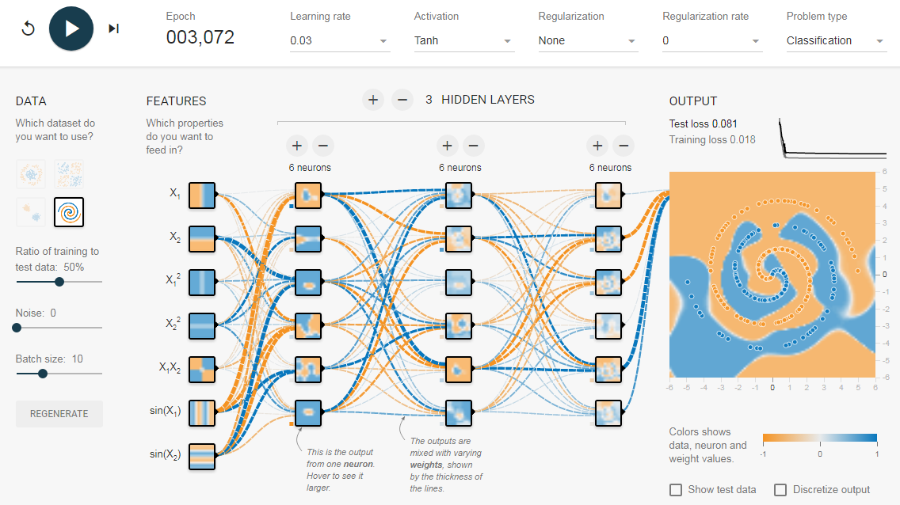
Neural Network Demo
Notes:
http://playground.tensorflow.org
http://playground.tensorflow.org/#activation=tanh&batchSize=10&dataset=spiral&regDataset=reg-plane&learningRate=0.03&regularizationRate=0&noise=0&networkShape=6,6,6&seed=0.19536&showTestData=false&discretize=false&percTrainData=50&x=true&y=true&xTimesY=true&xSquared=true&ySquared=true&cosX=false&sinX=true&cosY=false&sinY=true&collectStats=false&problem=classification&initZero=false&hideText=false

Slide 18
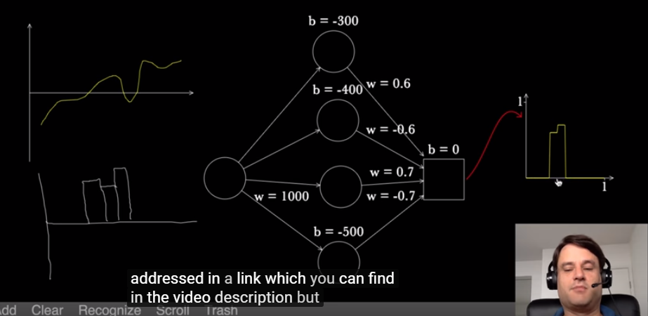
Why Neural Network
Each Problem can be presented by a combination of multiply polynomial problems
Universal approximation theorem
The layer structure in NN
Notes:
In the mathematical theory of artificial neural networks, the universal approximation theorem states^{[1]} that a feed-forward network with a single hidden layer containing a finite number of neurons (i.e., a multilayer perceptron), can approximate continuous functions on compact subsets of R^{n}, under mild assumptions on the activation function. The theorem thus states that simple neural networks can represent a wide variety of interesting functions when given appropriate parameters;

Slide 19
Design, train and prediction
The design of the model is to:
Select the input features (feature engineering)
Define how many hidden layers and how many nodes in each hidden layer
Select the activation function of each node
The training of the model is to:
Choose the weight matrix by training set and test set
The prediction of the model is to:
Using the trained model to predict result based on user’s input data
Notes:
In the mathematical theory of artificial neural networks, the universal approximation theorem states^{[1]} that a feed-forward network with a single hidden layer containing a finite number of neurons (i.e., a multilayer perceptron), can approximate continuous functions on compact subsets of R^{n}, under mild assumptions on the activation function. The theorem thus states that simple neural networks can represent a wide variety of interesting functions when given appropriate parameters;

Slide 20
Tradeoff
The tradeoff between data and algorithm
A better algorithm can solve the problem in short time, but how to design the better algorithm need extra time;
Complicated problem can be fixed by Complicated NN Structure, if have enough data and enough computation power;

